Slide 1
Introduction to Programming
John DeVries

Slide 2
Modern Programming Languages
Object Orientation
Functions (Methods)
Code Libraries
Event-Driven Architecture
Complex Types
Properties (encapsulation)
Namespaces
Inheritance
Overloading (polymorphism)
Identifier collision prevention
Reusability
Capture user input
Interfaces
Decoupled Code
Interfaces
Dependency injection

Slide 3
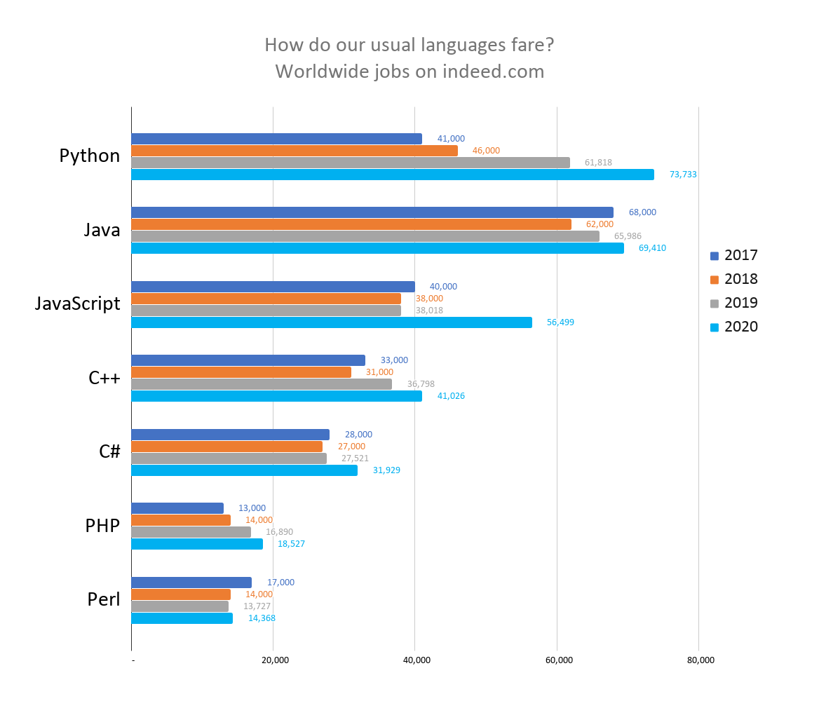
Programming Languages

Slide 4
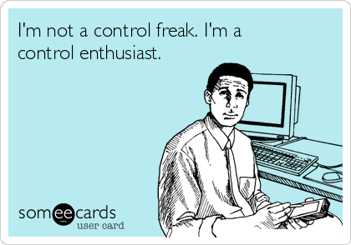
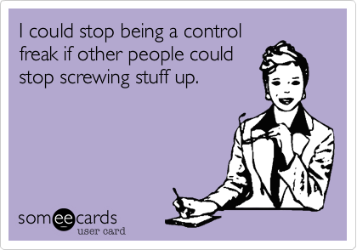
Foundations of Good Programming
Absolute Control!!

Slide 5
.Net System
Managed Code
Build/Compile
Intermediate Language
C#
Machine Code
Visual Basic
CLR
F#
Assembly
(.dll or .exe)
Unmanaged Code
Other Compiled Code

Slide 6
Understanding an application
High-level organization
(OOP, classes, properties, methods)
Low-level details
(variables, functions, branching, looping)
Tools
Code editing
Source Code Control
PROGRAM

Slide 7
Parts of the .Net system
Class Libraries
.Net
Tools
Visual Studio
Visual Studio Code
Programming Language
C#

Slide 8
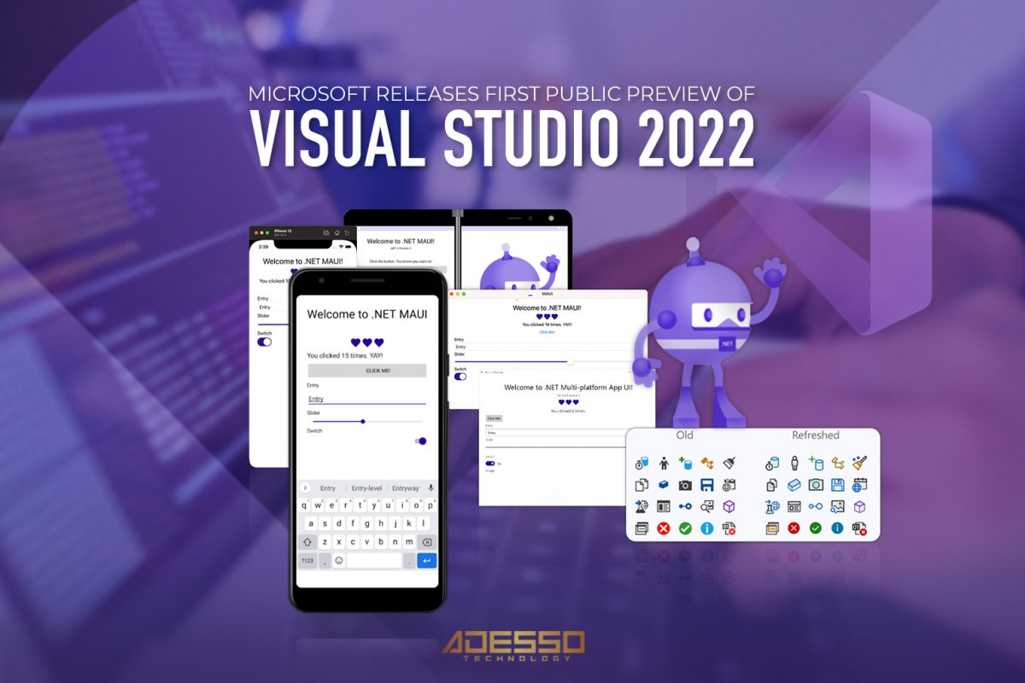
Visual Studio

Slide 9
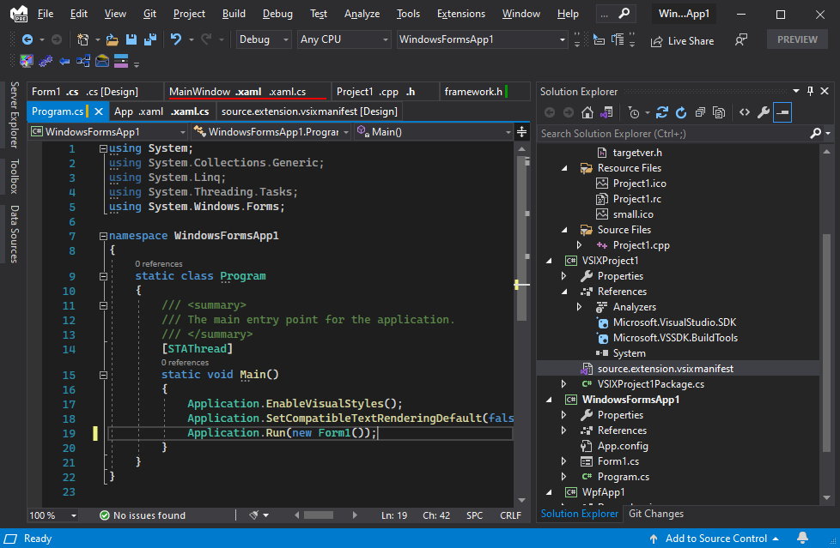
Visual Studio

Slide 10
VS Build Process
Save All
Build (compile) code
Load app on IIS Express (MS Web Server) and assign port
Opens browser and goes to localhost:port for app
Visual Studio
Start with or without debug

Slide 11
Elements of a program
Ways to represent data in memory
Ways to manipulate data in memory
Ways to show data and actions to users
Ways to persist data outside of memory

Slide 12
Elements of a program
Ways to represent data in memory
Ways to manipulate data in memory
Ways to show data and actions to users
Ways to persist data outside of memory
Variables and Constants
Operators and Expressions
User Interface Framework
Files and Databases
Data Types

Slide 13
Elements of a program
Ways to represent data in memory
Ways to manipulate data in memory
Ways to show data and actions to users
Ways to persist data outside of memory
Variables and Constants
Operations and Expressions
User Interface Framework
Files and Databases
Data Types

Slide 14
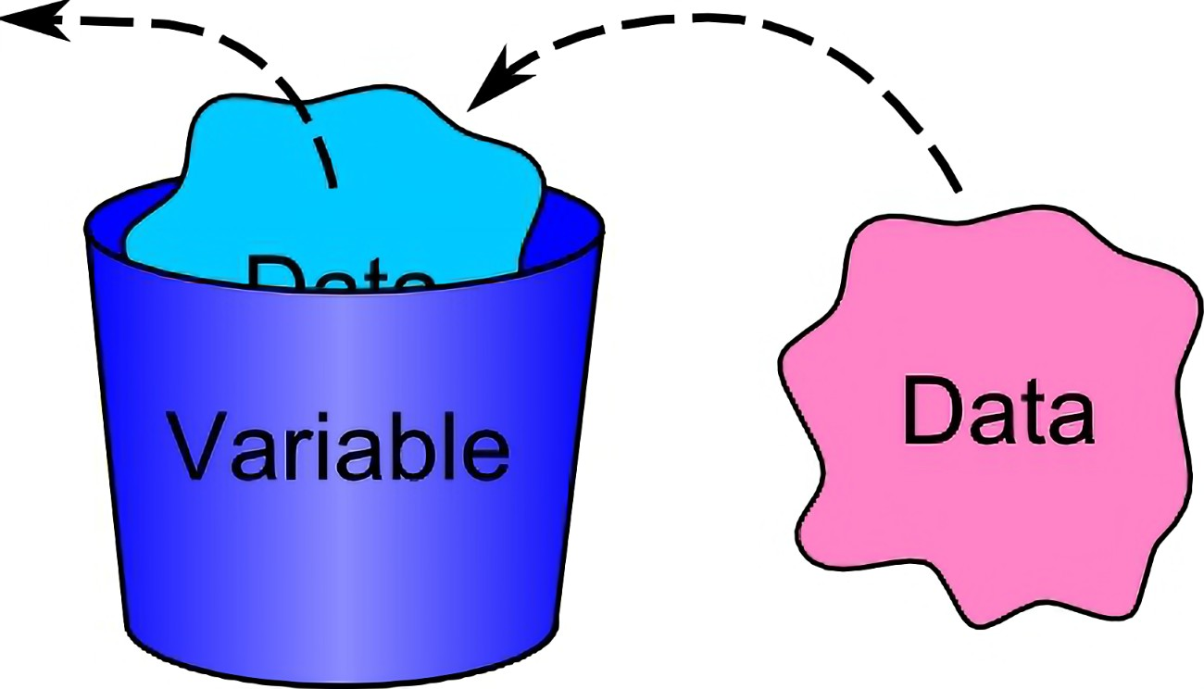
Variables and Constants

Slide 15
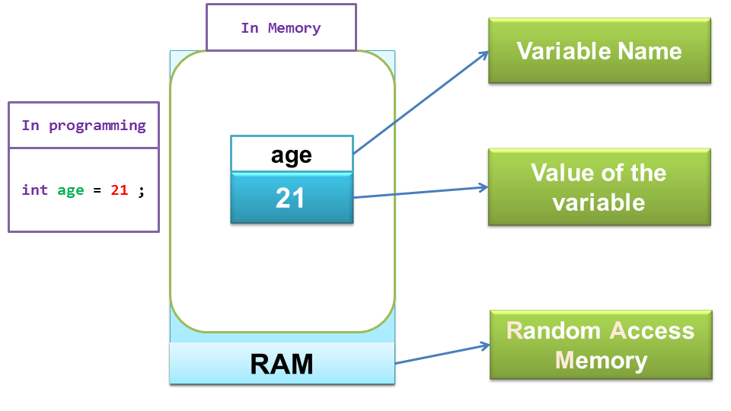
Variables and Constants

Slide 16
Casing Conventions
myNum - camel case
MyProp - Pascal case

Slide 17
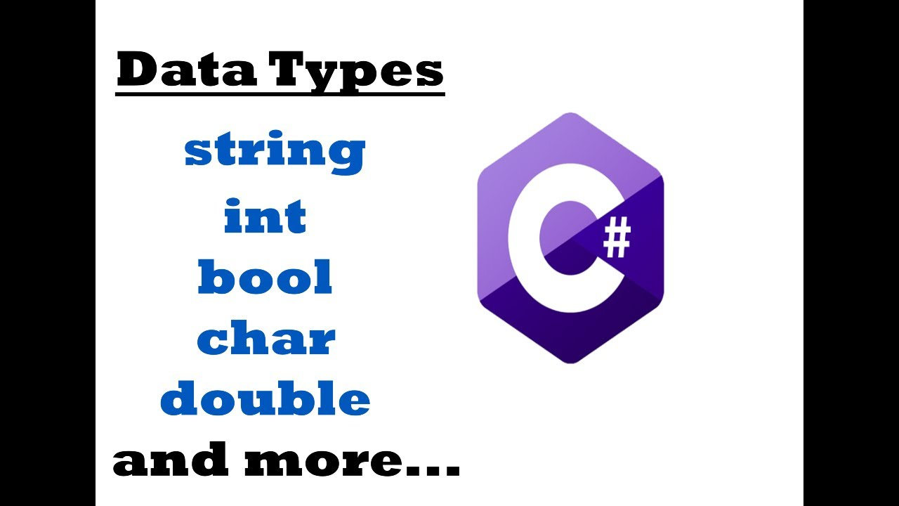
Data Types

Slide 18
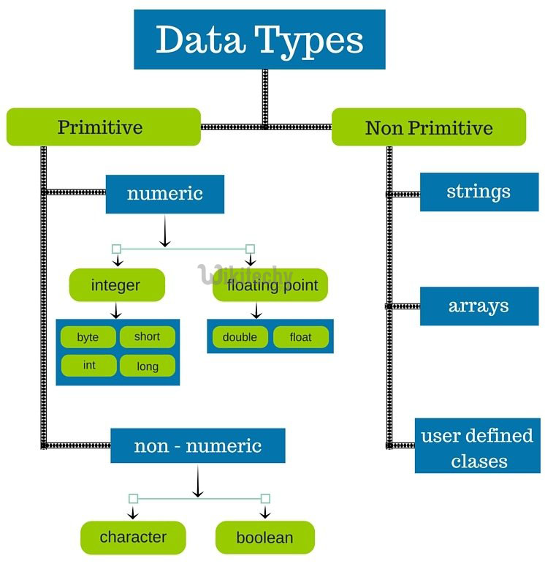
More Complete Data Types

Slide 19
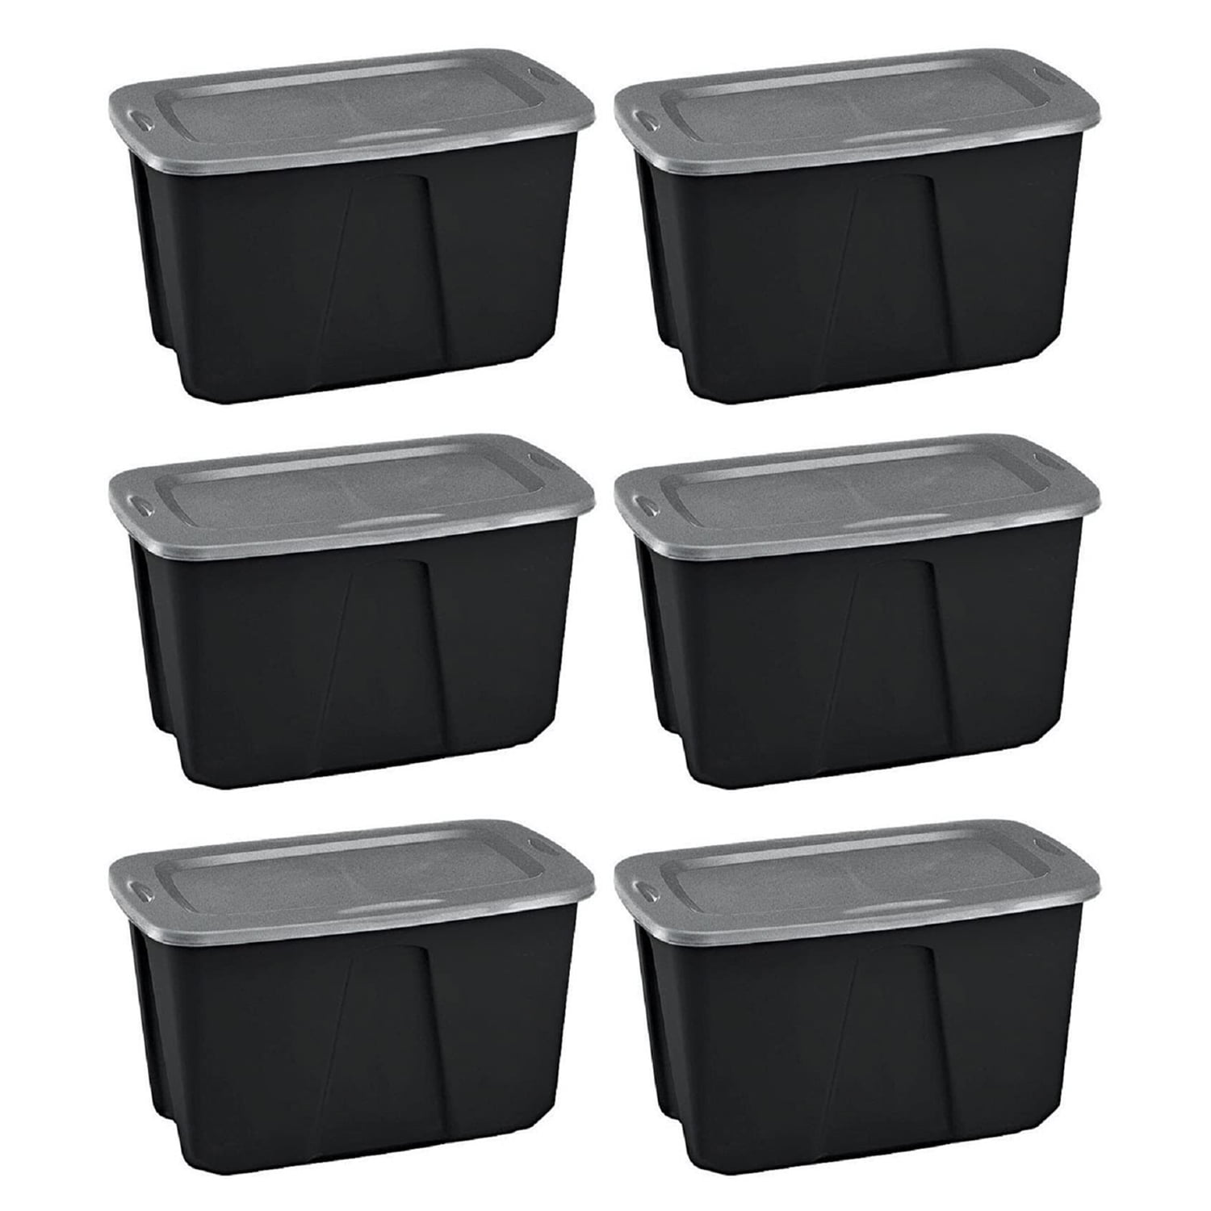
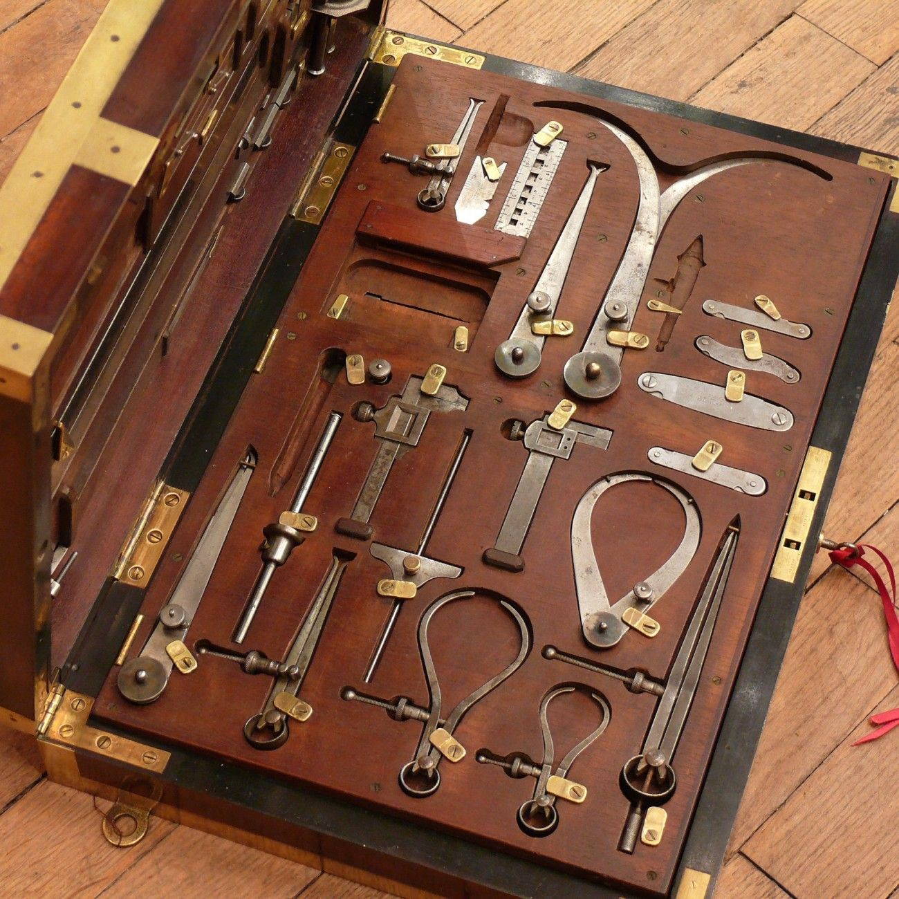
Choosing a Data Type
VS

Slide 20
Choosing a Data Type
DO NOT choose a type to save memory
Literally not worth your time
DO choose a type to prevent errors
e.g. Use an unsigned int to store age
uint age = 35

Slide 21
Elements of a program
Ways to represent data in memory
Ways to manipulate data in memory
Ways to show data and actions to users
Ways to persist data outside of memory
Variables and Constants
Operators and Expressions
User Interface Framework
Files and Databases
Data Types

Slide 22
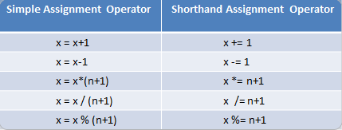
Assignment Operator
The “=“ means assignment, not equality
Assignment should be read from right to left
Shorthand assignment operators rarely used in modern code
Int age = 35

Slide 23
Evaluating an Assignment
int x = 2;
int x = y;
int x = x+y;

Slide 24
C# Operators
Category | Operators
Arithmetic | + - * / %
Relational | == != < <= > >=
Logical | ! && ||

Slide 25
Expressions
Expression == Data + Operators
May evaluate to any data type
Condition is a type of Expression
May only evaluate to a Boolean (true or false)
int num0fThings = someThings + otherThings
int num0fThings == someThings + otherThings

Slide 26
Flow – The thread of execution
Step 1
Step 2
Step 3
Begin thread of execution

Slide 27
Branch
Step 4a
Step 5a
Step 6a
…
Step 1
Step 2
Step 3
TRUE
CONDITION
Step 4b
Step 5b
Step 6b
…
FALSE

Slide 28
Loop
Step 1
Step 2
Step 3
Step 4
Step 5
…
FALSE
Test Loop Condition
Loop Step 1
Loop Step 2
Loop Step 3
Loop Step 4
TRUE

Slide 29

Software Architecture – Organizing Your Code
The goal is Maintainability
Findability
If you can’t find it, you can’t fix or modify it

Slide 30
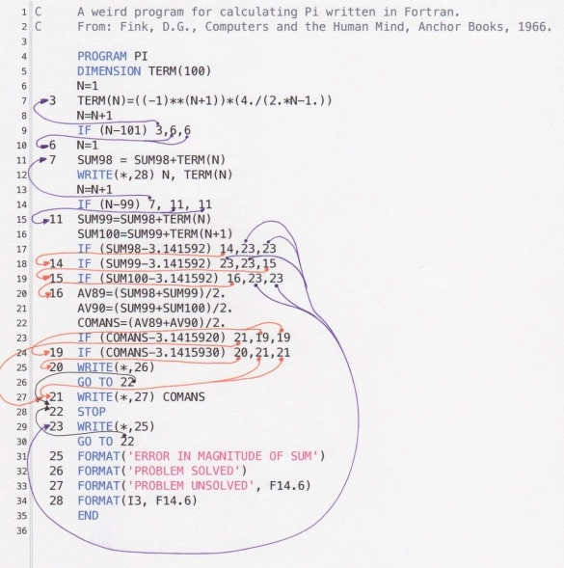
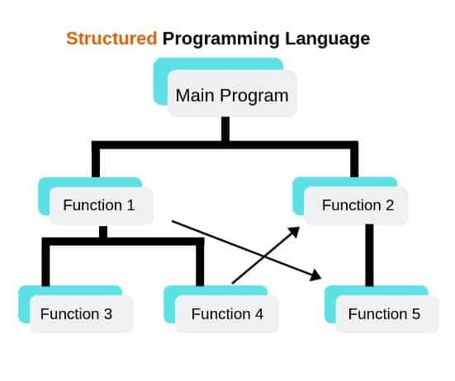
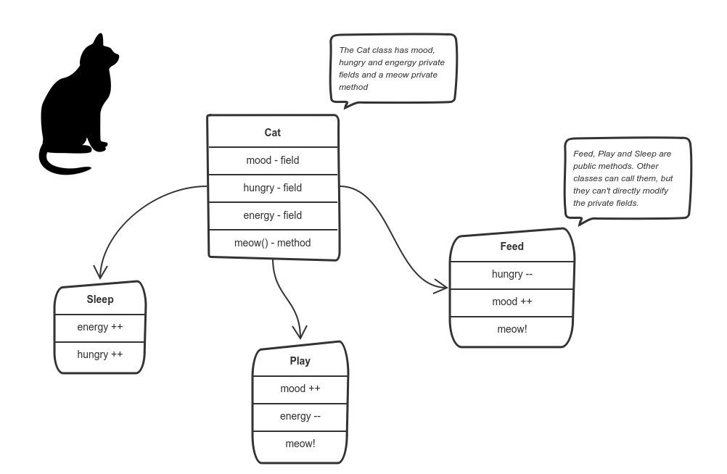
Evolution of Programming Architectures
Unstructured (spaghetti code)
Structured (functions)
Object Oriented (objects)

Slide 31
Stages of Programming
Stage 1 – Simple programming
All code in a single block
Stage 2 – Structured programming
Code is broken functional blocks, each with a specific job and a name
Call a function when you need to do that task
Stage 3 – Object Oriented Programming
Organize data and actions around the real-world object that the code is manipulating

Slide 32
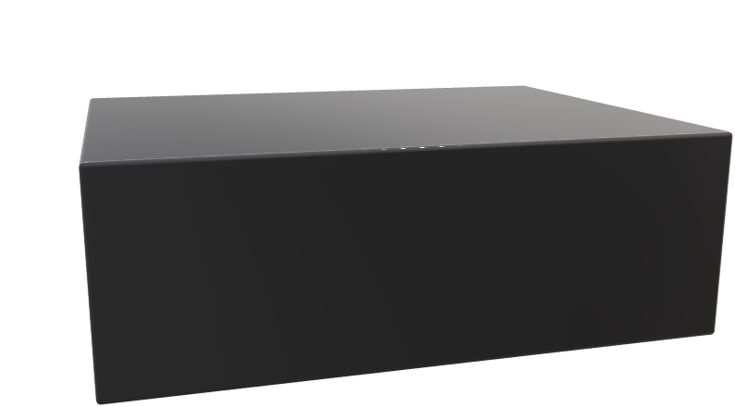
Methods
parameters
int Plusmethod(int x, int y)
{Return x+y}
Define method
return
x
y
arguments
Use (Call) method
Plusmethod(4, 5)

Slide 33
Methods
parameters
void Plusmethod(int x, int y)
{x+y}
Define method
x
y
arguments
Use (Call) method
Plusmethod(4, 5)

Slide 34
Functions
A Method is a Function inside of a Class
In C#, all functions are Methods
Definition of method
MethodName(param1, param2, …)
Value in program
Using method
MethodName(argument1, argument2, …)

Slide 35
Method in Use
Definition of method
SetAppointment(owner, datetime, …)
Value in program
Value in program
Using method
SetAppointment(DeVries, 7/7/2020, …)

Slide 36
Collections
Used to hold groups of data items of the same type
List
Dictionary
Value
Key
Value
3
Monday
3
5
Tuesday
5

Slide 37
Object Oriented Programming

Slide 38
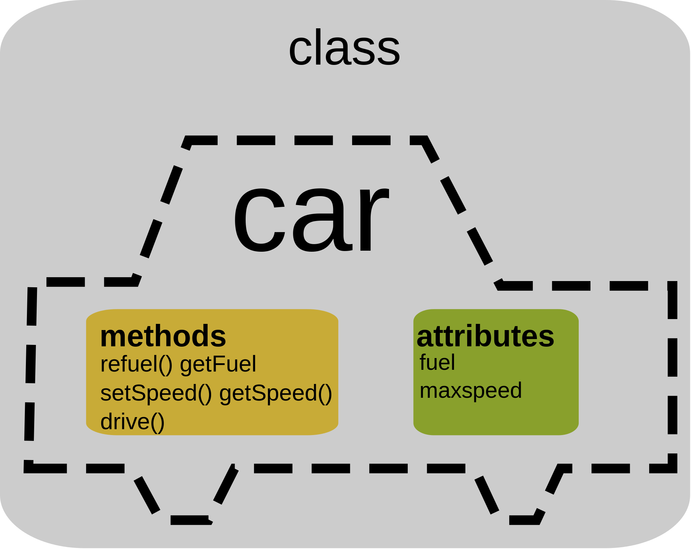

Slide 39
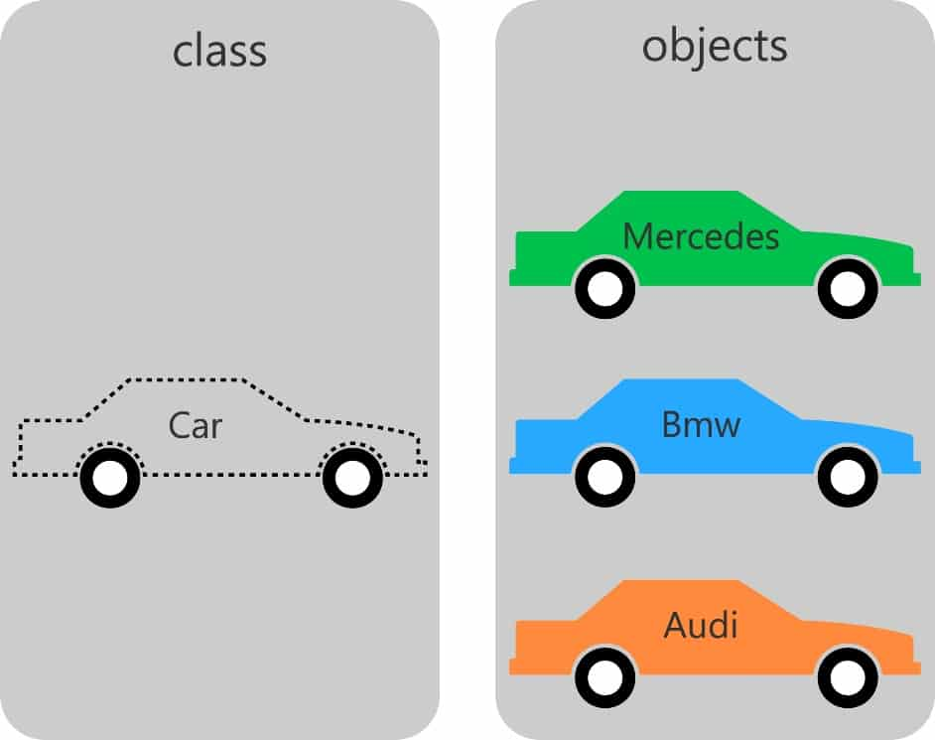

Slide 40


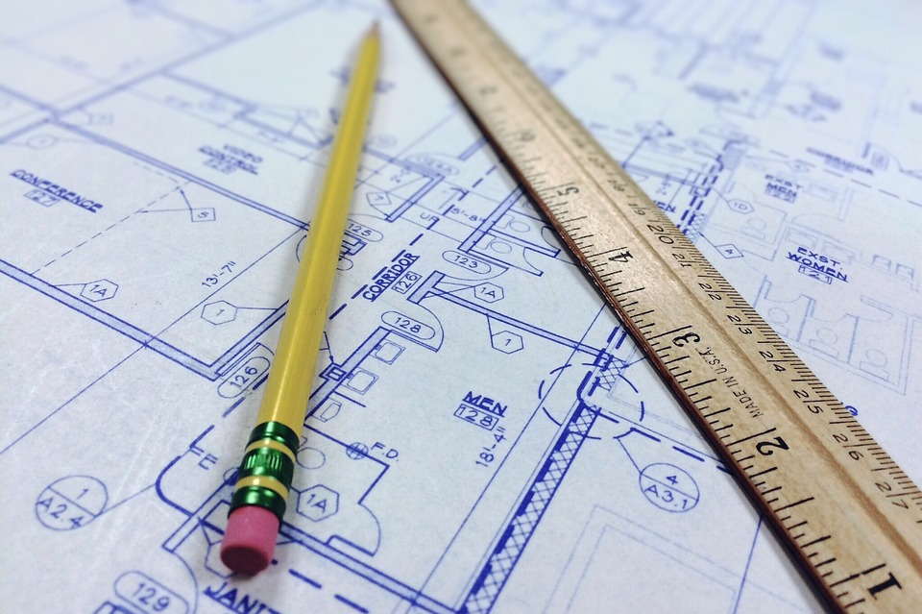
Classes
Object (executable)
Type: Bungalow1
Constructor
Class (description)
Class Name: Bungalow1
instantiation
Properties
Methods
Constructor
Other

Slide 41
Members of a Class
Fields are local scope variables in a Class
Properties hold data in memory
We call classes that are mostly Properties “models”
Methods perform actions on data

Slide 42
A Sample Class
Class CreditCourse
{
int courseId;
string courseName;
int courseLength;
CreditCourse()
{
}
}

Slide 43
Instantiating a Class
Complex data type
variable
constructor
CreditCourse creditCourse = new CreditCourse();
or var
or creditCourse1
or foo
Specify data type
Of variable
Assign to
variable
Creates a new instance of class (object)

Slide 44
Class Design
Vet Practice App
Class Animal
Class Appointment
Action | Class | Method
Register new owner | Owner | CreateNewOwner
Assign a vet to a pet (optional) | Pet | AssignVet
Register pet | Pet | RegisterPet
Make an appointment | Appointment | CreateAppt
Cancel appointment | Appointment | CancelAppt
Change appointment | Appointment | ChangeAppt
Make pet inactive | Pet | MakeInactive
properties
properties
Methods
Constructor
RegisterPet
AssignVet
Methods
Constructor
CreateAppt
CancelAppt
ChangeAppt
Class
Vet
Class
Owner
properties
properties
Methods
Constructor
Methods
Constructor
CreatNewOwner

Slide 45
Typical Class
Class Properties
Complex Data Type
Class Animal
{
string PetName
string Owner
char Gender
datetime DoB
int AmountOfFood
string BloodType
list Medications[]
string Species
float Height
float Weight
bool Spayed/Neutered
}

Slide 46
Consuming a Class Library
Define Classes and/or Methods as “static”
Do not need to be instantiated, you just use them
Instantiate an Object from the Class library
Inherit the Base Class from the Class library
Extend it to customize for your application

Slide 47
Working with an external service
External Service
(File or DB or Network or …)
In-Memory Proxy for External Service
(Client or Context Object)
Your Code

Slide 48
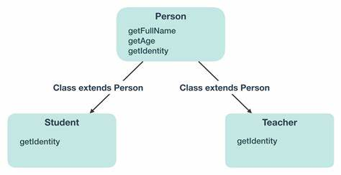
OOP - Inheritance

Slide 49
OOP - Inheritance
Dog
-Breed
Abstract Base Class
Pet
:
Cat
Reptile
-Owner
-Name
-DoB
-Weight
…
(-Species)?
Bird
Fish
- Fresh or salt water

Slide 50
OOP- Polymorphism
AddNums (a,b)
sum=a+b
return sum
AddNums (a,b,c)
sum=a+b+c
return sum
AddNums (a,b,c,d)
sum=a+b+c+d
return sum

Slide 51
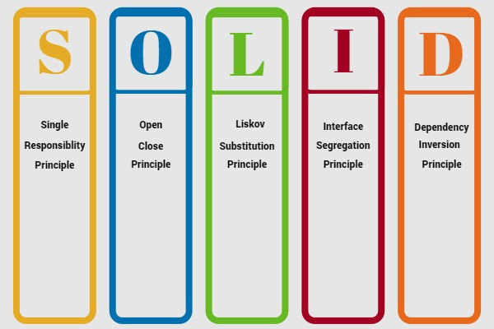
Foundations of Good Programming

Slide 52
Data Persistence

Slide 53
OS:
Windows or
Linux or
MacOS
Program executing in memory
Create a file
Open a file
Read from file
Write to file
I/O
File on HDD
Code
Stream
I/O
File on SSD
I/O
File on SAN
Abstraction
I/O
File on Cloud Storage

Slide 54
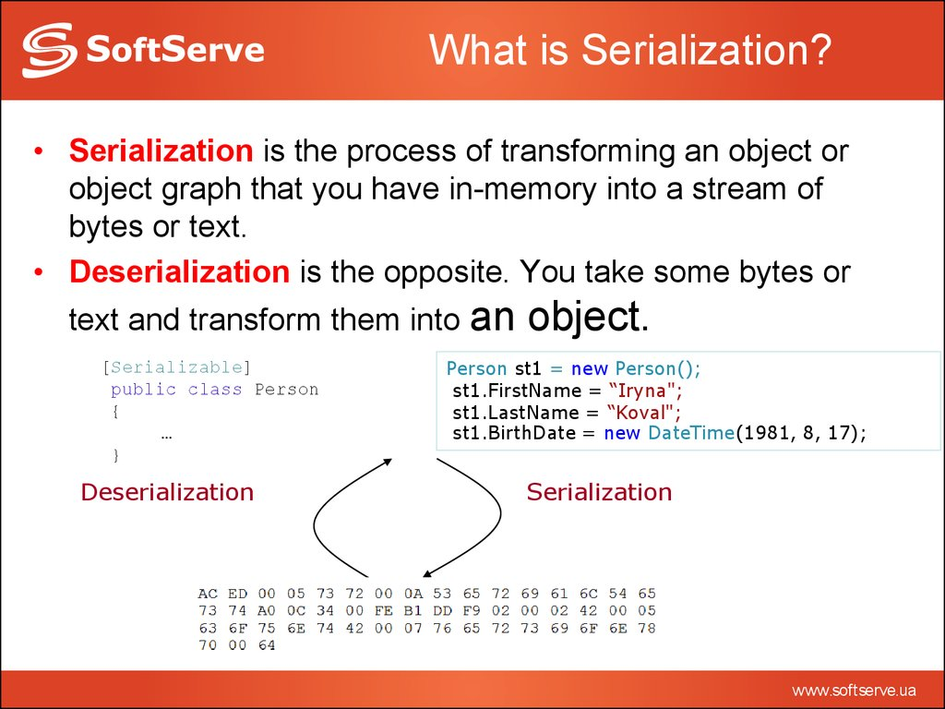

Slide 55
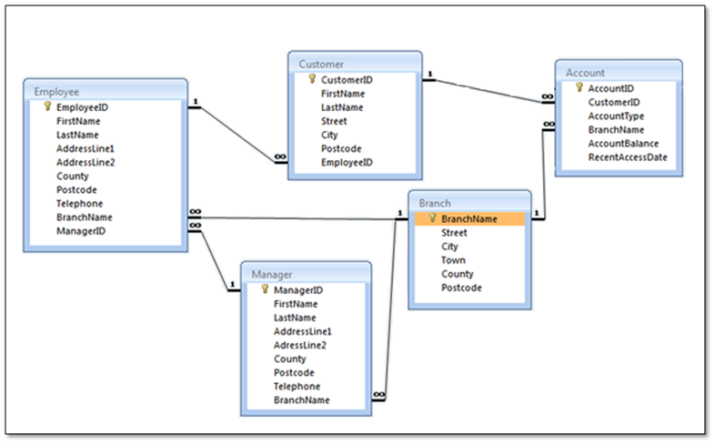
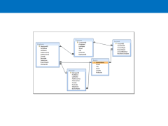

Slide 56
Class: Person
Property: ID
Property:FirstName
…
Object: Person1
Table: Person
ID | FirstName | LastName | DoB
Object: Person2
Object: Person3

Slide 57
.Net Program
Relational Database
Cache
ADO.Net
Provider
Table1
Field1
Field2
DataClass1
Prop1
Prop2
LINQ
Entity Framework
Data
Class 2

Slide 58
Program
myContext:DbContext
Database
Read
DBSet

Slide 59
Program
Your code
Database
myContext: DbContext
DBSet
SaveChanges()
Write

Slide 60
User Interface

Slide 61
Graphical User Interface (GUI)
Desktop
XAML
.Net MAUI
Web App
HTML, CSS & JavaScript
Razor
Web API
Server-to-Server
No UI needed
Blazor
JS Framework (Angular, React, Vue, etc.)
Xamarin

Slide 62
UI Issues
Dynamic Data
Data Binding
Page Composition
Create page from reusable pieces
Event Handling
Event Object
Event source
Event properties

Slide 63
Event Generator
Event Listener
Event object
Event
object
Event Handler

Slide 64
Main_entry
Method1
Method2
Method3
method4
Garbage Collector
Scope
Scope
Scope
Scope
Scope

Slide 65
Memory
Reference Type
variable
Value Type
copy
variable

Slide 66
Memory
Reference Type
Variable x
reference
Value Type
copy
Variable y

Slide 67
Scope
C# uses block scope
Global Scope
Scope 2a
Scope 2b
Int age
MyClass
Thread of Execution
parameter
Int id
Scope 3
return
Int age
New MyClass
id

Slide 68
C# Resources
C# Tutorial (C Sharp) (w3schools.com)
C# Coding Conventions - C# Programming Guide | Microsoft Docs
Visual Studio IDE, Code Editor, Azure DevOps, & App Center - Visual Studio (microsoft.com)
.NET | Free. Cross-platform. Open Source. (microsoft.com)
.NET developer community | Connect with like-minded developers (microsoft.com)
.NET API browser | Microsoft Docs
C# Fundamentals for Absolute Beginners | Channel 9 (msdn.com)
Free ebooks for .NET & JavaScript Developers | Syncfusion
Amazon.com: Rockin the C# Interview: 2017 Edition: A comprehensive question and answer reference guide for the C# programming language. eBook: Unger, Greg: Kindle Store
Learning C# by Developing Games with Unity 2020 - Fifth Edition | Packt (packtpub.com)
https://www.dotnetcurry.com/

Slide 69
C# Tutorials
.NET In-Browser Tutorial - Step 1: Intro (microsoft.com)
Introduction to C# - interactive tutorials | Microsoft Docs
https://docs.microsoft.com/en-us/dotnet/core/tutorials/with-visual-studio
https://docs.microsoft.com/en-us/dotnet/core/tutorials/with-visual-studio-code
350+ C# Practice Exercises // Edabit

Slide 70
Sunset of the IDEs
DEVOPS
e.g. VS Code
IDE
e.g. Visual Studio
Code run in an environment that is “sort of” like production
Code run and tested in environment identical to production

